Slide 1

Cryptography and Network Security
Seventh Edition
by William Stallings
Notes:
Lecture slides prepared for “Cryptography and Network Security”, 7/e, by William Stallings, Chapter 6 – “Advanced Encryption Standard”.

Slide 2
Chapter 6
Advanced Encryption Standard
Notes:
The Advanced Encryption Standard (AES) was published by the National Institute
of Standards and Technology (NIST) in 2001. AES is a symmetric block cipher that
is intended to replace DES as the approved standard for a wide range of applications.
Compared to public-key ciphers such as RSA, the structure of AES and most symmetric
ciphers is quite complex and cannot be explained as easily as many other cryptographic
algorithms. Accordingly, the reader may wish to begin with a simplified version
of AES, which is described in Appendix 5B. This version allows the reader to perform
encryption and decryption by hand and gain a good understanding of the working of
the algorithm details. Classroom experience indicates that a study of this simplified
version enhances understanding of AES. One possible approach is to read the chapter
first, then carefully read Appendix W, and then re-read the main body of the chapter.
Appendix H looks at the evaluation criteria used by NIST to select from among
the candidates for AES, plus the rationale for picking Rijndael, which was the winning
candidate. This material is useful in understanding not just the AES design but also the
criteria by which to judge any symmetric encryption algorithm.

Slide 3
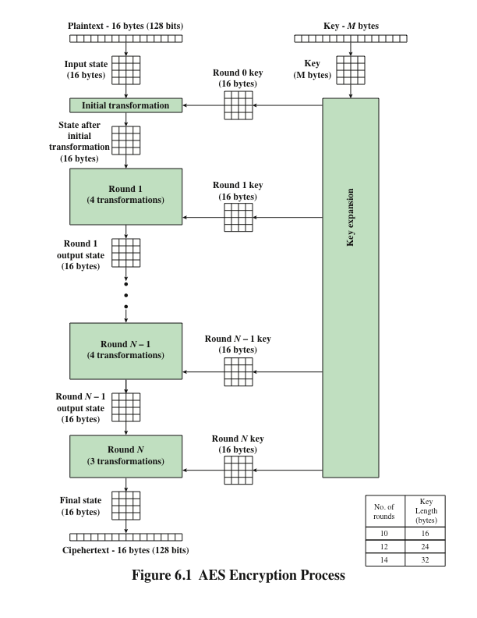
Notes:
Figure 6.1 shows the overall structure of the AES encryption process. The cipher
takes a plaintext block size of 128 bits, or 16 bytes. The key length can be 16, 24, or
32 bytes (128, 192, or 256 bits). The algorithm is referred to as AES-128, AES-192, or
AES-256, depending on the key length.

Slide 4
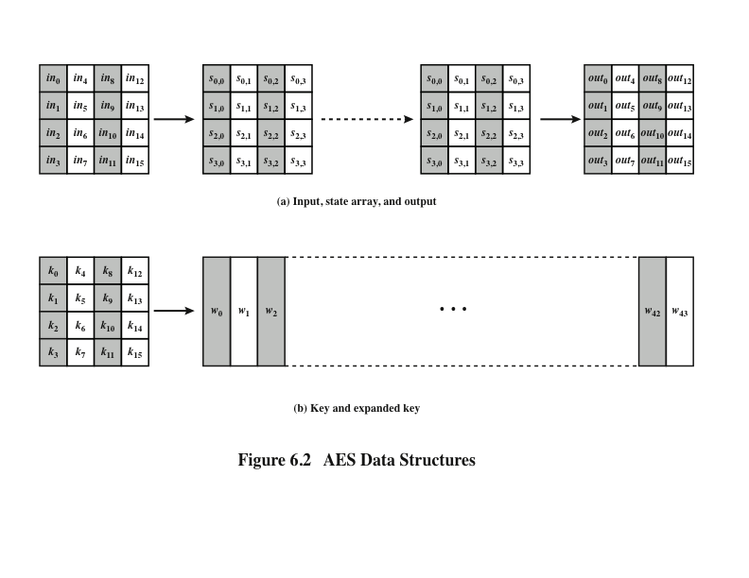
Notes:
The input to the encryption and decryption algorithms is a single 128-bit block.
In FIPS PUB 197, this block is depicted as a 4 * 4 square matrix of bytes. This
block is copied into the State array, which is modified at each stage of encryption or
decryption. After the final stage, State is copied to an output matrix. These operations
are depicted in Figure 6.2a. Similarly, the key is depicted as a square matrix of bytes.
This key is then expanded into an array of key schedule words. Figure 6.2b shows the
expansion for the 128-bit key. Each word is four bytes, and the total key schedule
is 44 words for the 128-bit key. Note that the ordering of bytes within a matrix is by
column. So, for example, the first four bytes of a 128-bit plaintext input to the encryption
cipher occupy the first column of the in matrix, the second four bytes occupy the
second column, and so on. Similarly, the first four bytes of the expanded key, which
form a word, occupy the first column of the w matrix.

Slide 5
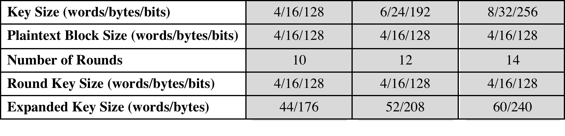
Table 6.1
AES Parameters
Notes:
The cipher consists of N rounds, where the number of rounds depends on the
key length: 10 rounds for a 16-byte key, 12 rounds for a 24-byte key, and 14 rounds
for a 32-byte key (Table 6.1). The first N - 1 rounds consist of four distinct transformation
functions: SubBytes, ShiftRows, MixColumns, and AddRoundKey, which are
described subsequently. The final round contains only three transformations, and
there is a initial single transformation (AddRoundKey) before the first round, which
can be considered Round 0. Each transformation takes one or more 4 * 4 matrices
as input and produces a 4 * 4 matrix as output. Figure 6.1 shows that the output of
each round is a 4 * 4 matrix, with the output of the final round being the ciphertext.
Also, the key expansion function generates N + 1 round keys, each of which is a distinct
4 * 4 matrix. Each round key serves as one of the inputs to the AddRoundKey
transformation in each round.

Slide 6
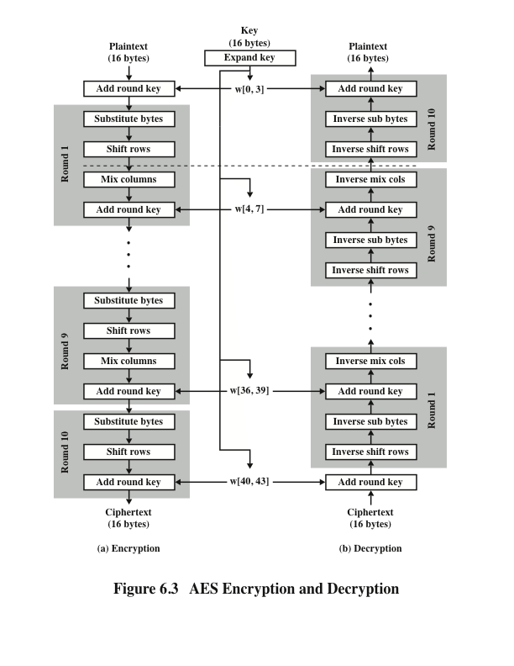
Notes:
Figure 6.3 shows the AES cipher in more detail, indicating the sequence of transformations
in each round and showing the corresponding decryption function. As was
done in Chapter 4, we show encryption proceeding down the page and decryption
proceeding up the page.

Slide 7
Detailed Structure
Processes the entire data block as a single matrix during each round using substitutions and permutation
The key that is provided as input is expanded into an array of forty-four 32-bit words, w[i]
The cipher begins and ends with an AddRoundKey stage
Can view the cipher as alternating operations of XOR encryption (AddRoundKey) of a block, followed by scrambling of the block (the other three stages), followed by XOR encryption, and so on
Each stage is easily reversible
The decryption algorithm makes use of the expanded key in reverse order, however the decryption algorithm is not identical to the encryption algorithm
State is the same for both encryption and decryption
Final round of both encryption and decryption consists of only three stages
Four different stages are used:
Substitute bytes – uses an S-box to perform a byte-by-byte substitution of the block
ShiftRows – a simple permutation
MixColumns – a substitution that makes use of arithmetic over GF(2⁸)
AddRoundKey – a simple bitwise XOR of the current block with a portion of the expanded key
Notes:
Before delving into details, we can make several comments about the overall
AES structure.
1. One noteworthy feature of this structure is that it is not a Feistel structure.
Recall that, in the classic Feistel structure, half of the data block is used to
modify the other half of the data block and then the halves are swapped. AES
instead processes the entire data block as a single matrix during each round
using substitutions and permutation.
2. The key that is provided as input is expanded into an array of forty-four 32-bit
words, w [i ]. Four distinct words (128 bits) serve as a round key for each round;
these are indicated in Figure 6.3.
3. Four different stages are used, one of permutation and three of substitution:
• Substitute bytes: Uses an S-box to perform a byte-by-byte substitution of
the block
• ShiftRows: A simple permutation
• MixColumns: A substitution that makes use of arithmetic over GF(2⁸ )
• AddRoundKey: A simple bitwise XOR of the current block with a portion
of the expanded key
4. The structure is quite simple. For both encryption and decryption, the
cipher begins with an AddRoundKey stage, followed by nine rounds that each
includes all four stages, followed by a tenth round of three stages.
5. Only the AddRoundKey stage makes use of the key. For this reason, the cipher
begins and ends with an AddRoundKey stage. Any other stage, applied at the
beginning or end, is reversible without knowledge of the key and so would add
no security.
6. The AddRoundKey stage is, in effect, a form of Vernam cipher and by itself
would not be formidable. The other three stages together provide confusion,
diffusion, and nonlinearity, but by themselves would provide no security
because they do not use the key. We can view the cipher as alternating operations
of XOR encryption (AddRoundKey) of a block, followed by scrambling
of the block (the other three stages), followed by XOR encryption, and so on.
This scheme is both efficient and highly secure.
7. Each stage is easily reversible. For the Substitute Byte, ShiftRows, and
MixColumns stages, an inverse function is used in the decryption algorithm.
For the AddRoundKey stage, the inverse is achieved by XORing the same
round key to the block.
8. As with most block ciphers, the decryption algorithm makes use of the
expanded key in reverse order. However, the decryption algorithm is not
identical to the encryption algorithm. This is a consequence of the particular
structure of AES.
9. Once it is established that all four stages are reversible, it is easy to verify
that decryption does recover the plaintext. Figure 6.3 lays out encryption
and decryption going in opposite vertical directions. At each horizontal point
(e.g., the dashed line in the figure), State is the same for both encryption and
decryption.
10. The final round of both encryption and decryption consists of only three stages.
Again, this is a consequence of the particular structure of AES and is required
to make the cipher reversible.

Slide 8
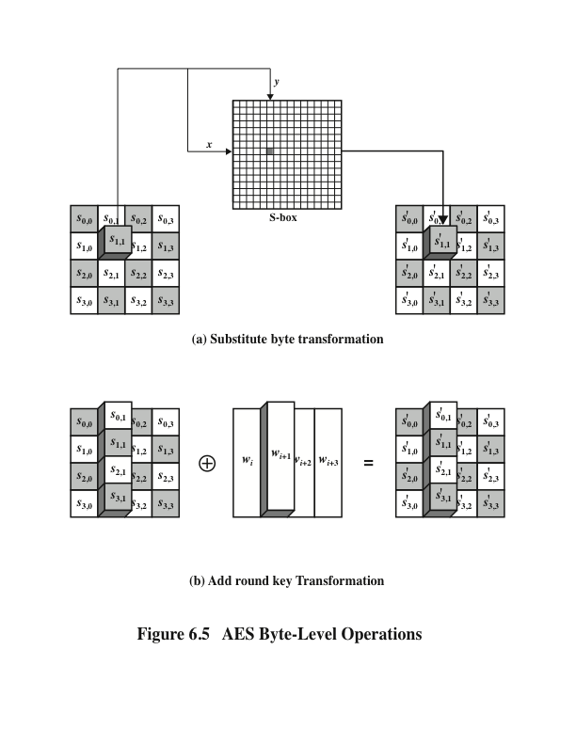
Notes:
The forward substitute byte transformation , called SubBytes, is a simple table lookup (Figure 6.5a).

Slide 9
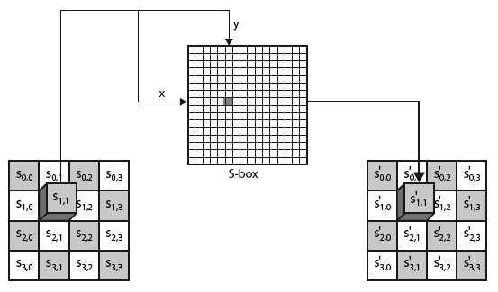
Byte Substitution

Slide 10
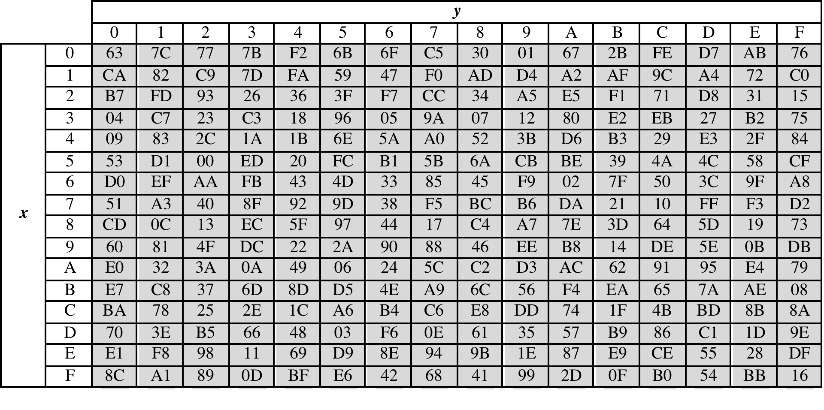
Table 6.2
(a) S-box
(Table can be found on page 163 in textbook)
Notes:
AES defines a 16 * 16 matrix of byte values, called an S-box (Table 6.2a), that contains
a permutation of all possible 256 8-bit values. Each individual byte of State
is mapped into a new byte in the following way: The leftmost 4 bits of the byte
are used as a row value and the rightmost 4 bits are used as a column value.
These row and column values serve as indexes into the S-box to select a unique
8-bit output value. For example, the hexadecimal value {95} references row 9,
column 5 of the S-box, which contains the value {2A}. Accordingly, the value {95}
is mapped into the value {2A}.

Slide 11
Byte Substitution example

Slide 12
Shift Row Rationale
More substantial than it may first appear
The State, as well as the cipher input and output, is treated as an array of four 4-byte columns
On encryption, the first 4 bytes of the plaintext are copied to the first column of State, and so on
The round key is applied to State column by column
  Thus, a row shift moves an individual byte from one column to another, which is a linear distance of a multiple of 4 bytes
Transformation ensures that the 4 bytes of one column are spread out to four different columns
Notes:
The shift row transformation is more substantial than it may first
appear. This is because the State , as well as the cipher input and output, is
treated as an array of four 4-byte columns. Thus, on encryption, the first 4 bytes
of the plaintext are copied to the first column of State , and so on. Furthermore,
as will be seen, the round key is applied to State column by column. Thus, a row
shift moves an individual byte from one column to another, which is a linear
distance of a multiple of 4 bytes. Also note that the transformation ensures that
the 4 bytes of one column are spread out to four different columns. Figure 6.4
illustrates the effect.

Slide 13
Shift Rows
a circular byte shift in each each
  1st row is unchanged
  2nd row does 1 byte circular shift to left
  3rd row does 2 byte circular shift to left
  4th row does 3 byte circular shift to left
decrypt inverts using shifts to right
since state is processed by columns, this step permutes bytes between the columns

Slide 14
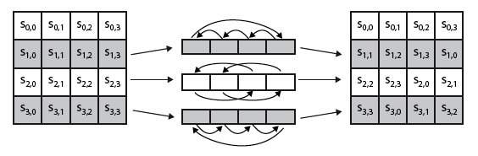
Shift Rows

Slide 15
Shift Row Example

Slide 16
Mix Columns Rationale
Coefficients of a matrix based on a linear code with maximal distance between code words ensures a good mixing among the bytes of each column
The mix column transformation combined with the shift row transformation ensures that after a few rounds all output bits depend on all input bits
Notes:
The coefficients of the matrix in Equation (6.3) are based on a linear
code with maximal distance between code words, which ensures a good mixing
among the bytes of each column. The mix column transformation combined with
the shift row transformation ensures that after a few rounds all output bits depend
on all input bits. See [DAEM99] for a discussion.
In addition, the choice of coefficients in MixColumns, which are all {01}, { 02},
or { 03}, was influenced by implementation considerations. As was discussed, multiplication
by these coefficients involves at most a shift and an XOR. The coefficients
in InvMixColumns are more formidable to implement. However, encryption was
deemed more important than decryption for two reasons:
1. For the CFB and OFB cipher modes (Figures 7.5 and 7.6; described in Chapter 7),
only encryption is used.
2. As with any block cipher, AES can be used to construct a message authentication
code (Chapter 13), and for this, only encryption is used.

Slide 17

Mix Columns
each column is processed separately
each byte is replaced by a value dependent on all 4 bytes in the column
effectively a matrix multiplication in GF(2⁸) using prime poly m(x) =x⁸+x⁴+x³+x+1

Slide 18
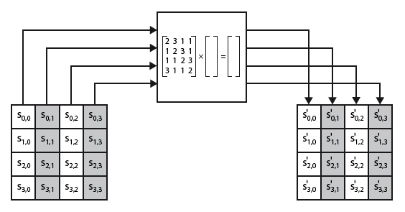
Mix Columns

Slide 19
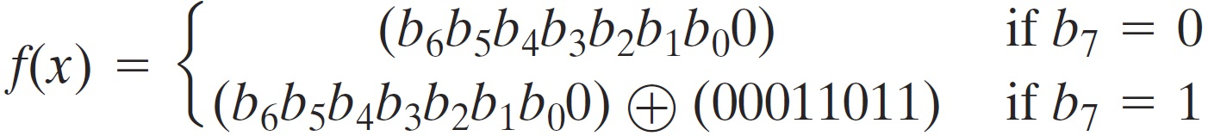
Mix Columns
can express each col as 4 equations
  to derive each new byte in col
decryption requires use of inverse matrix
  with larger coefficients, hence a little harder
have an alternate characterisation
  each column a 4-term polynomial
  with coefficients in GF(2⁸)
  and polynomials multiplied modulo (x⁴+1)

Slide 20
Mix Columns Example

Slide 21
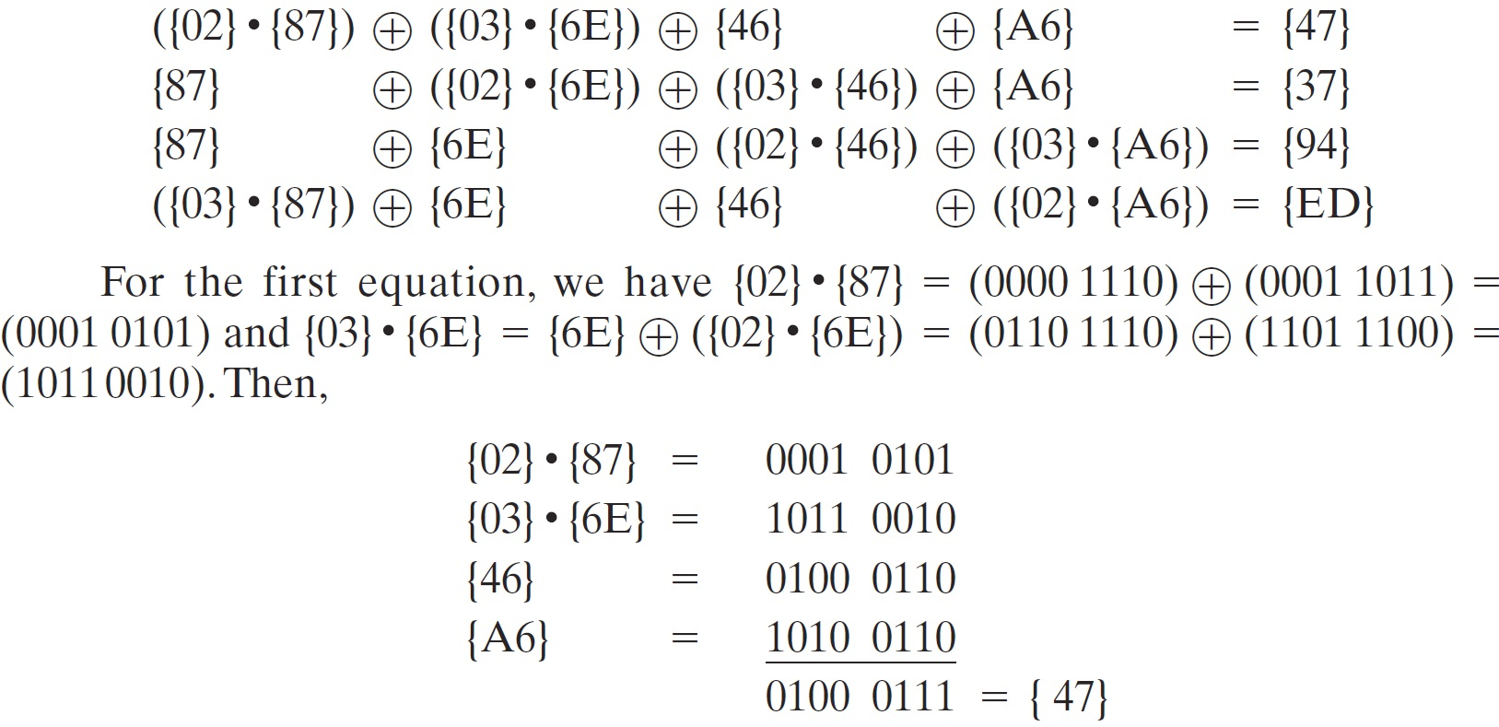
Mix Columns Example

Slide 22
Mix Columns Example
Multiplication by the value of {03} can be implemented as multiplication by {2} followed by XOR with the same number. For example: {03} . {6E} = {6E}⊕({02} . {6E})

Slide 23
AddRoundKey Transformation
The 128 bits of State are bitwise XORed with the 128 bits of the round key
Operation is viewed as a columnwise operation between the 4 bytes of a State column and one word of the round key
  Can also be viewed as a byte-level operation
Rationale:
Is as simple as possible and affects every bit of State
The complexity of the round key expansion plus the complexity of the other stages of AES ensure security
Notes:
In the forward add round key transformation ,
called AddRoundKey, the 128 bits of State are bitwise XORed with the 128
bits of the round key. As shown in Figure 6.5b, the operation is viewed as a columnwise
operation between the 4 bytes of a State column and one word of the round
key; it can also be viewed as a byte-level operation.
The add round key transformation is as simple as possible and affects
every bit of State . The complexity of the round key expansion, plus the complexity
of the other stages of AES, ensure security.

Slide 24
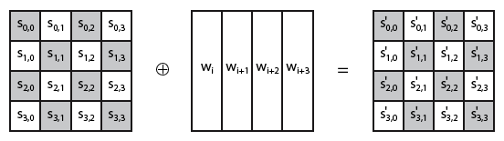
Add Round Key

Slide 25
AddRoundKey Example
Notes:
In the forward add round key transformation ,
called AddRoundKey, the 128 bits of State are bitwise XORed with the 128
bits of the round key. As shown in Figure 6.5b, the operation is viewed as a columnwise
operation between the 4 bytes of a State column and one word of the round
key; it can also be viewed as a byte-level operation.
The add round key transformation is as simple as possible and affects
every bit of State . The complexity of the round key expansion, plus the complexity
of the other stages of AES, ensure security.

Slide 26
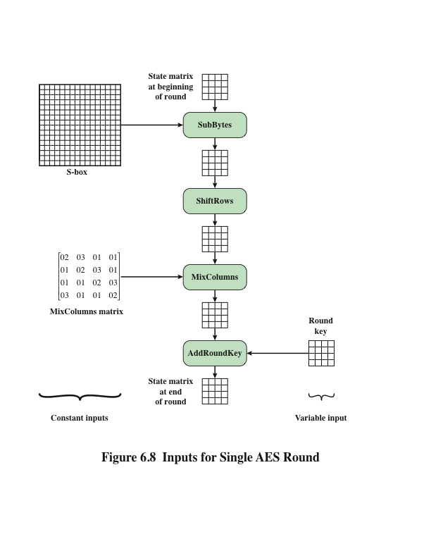
Notes:
Figure 6.8 is another view of a single round of AES, emphasizing the mechanisms
and inputs of each transformation.

Slide 27
AES Key Expansion
Takes as input a four-word (16 byte) key and produces a linear array of 44 words (176) bytes
  This is sufficient to provide a four-word round key for the initial AddRoundKey stage and each of the 10 rounds of the cipher
Key is copied into the first four words of the expanded key
  The remainder of the expanded key is filled in four words at a time
Each added word w[i] depends on the immediately preceding word, w[i – 1], and the word four positions back, w[i – 4]
  In three out of four cases a simple XOR is used
  For a word whose position in the w array is a multiple of 4, a more complex function is used
Notes:
The AES key expansion algorithm takes as input a four-word (16-byte) key and
produces a linear array of 44 words (176 bytes). This is sufficient to provide a four word
round key for the initial AddRoundKey stage and each of the 10 rounds of the
cipher. The pseudocode on the next page describes the expansion.
The key is copied into the first four words of the expanded key. The remainder
of the expanded key is filled in four words at a time. Each added word w [i]
depends on the immediately preceding word, w [i - 1], and the word four positions
back, w [i - 4]. In three out of four cases, a simple XOR is used. For a word whose
position in the w array is a multiple of 4, a more complex function is used.

Slide 28
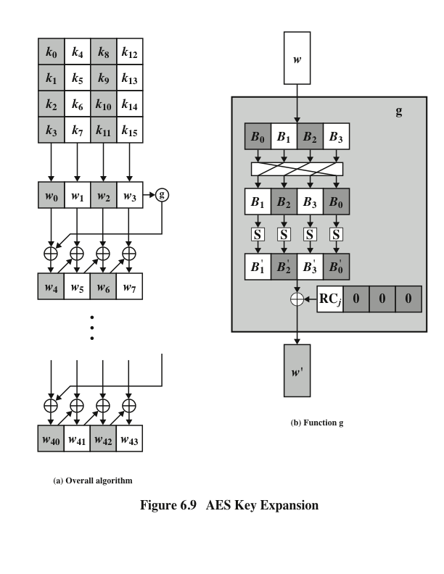
Notes:
Figure 6.9 illustrates the generation of the expanded key, using the symbol g to represent that
complex function.

Slide 29
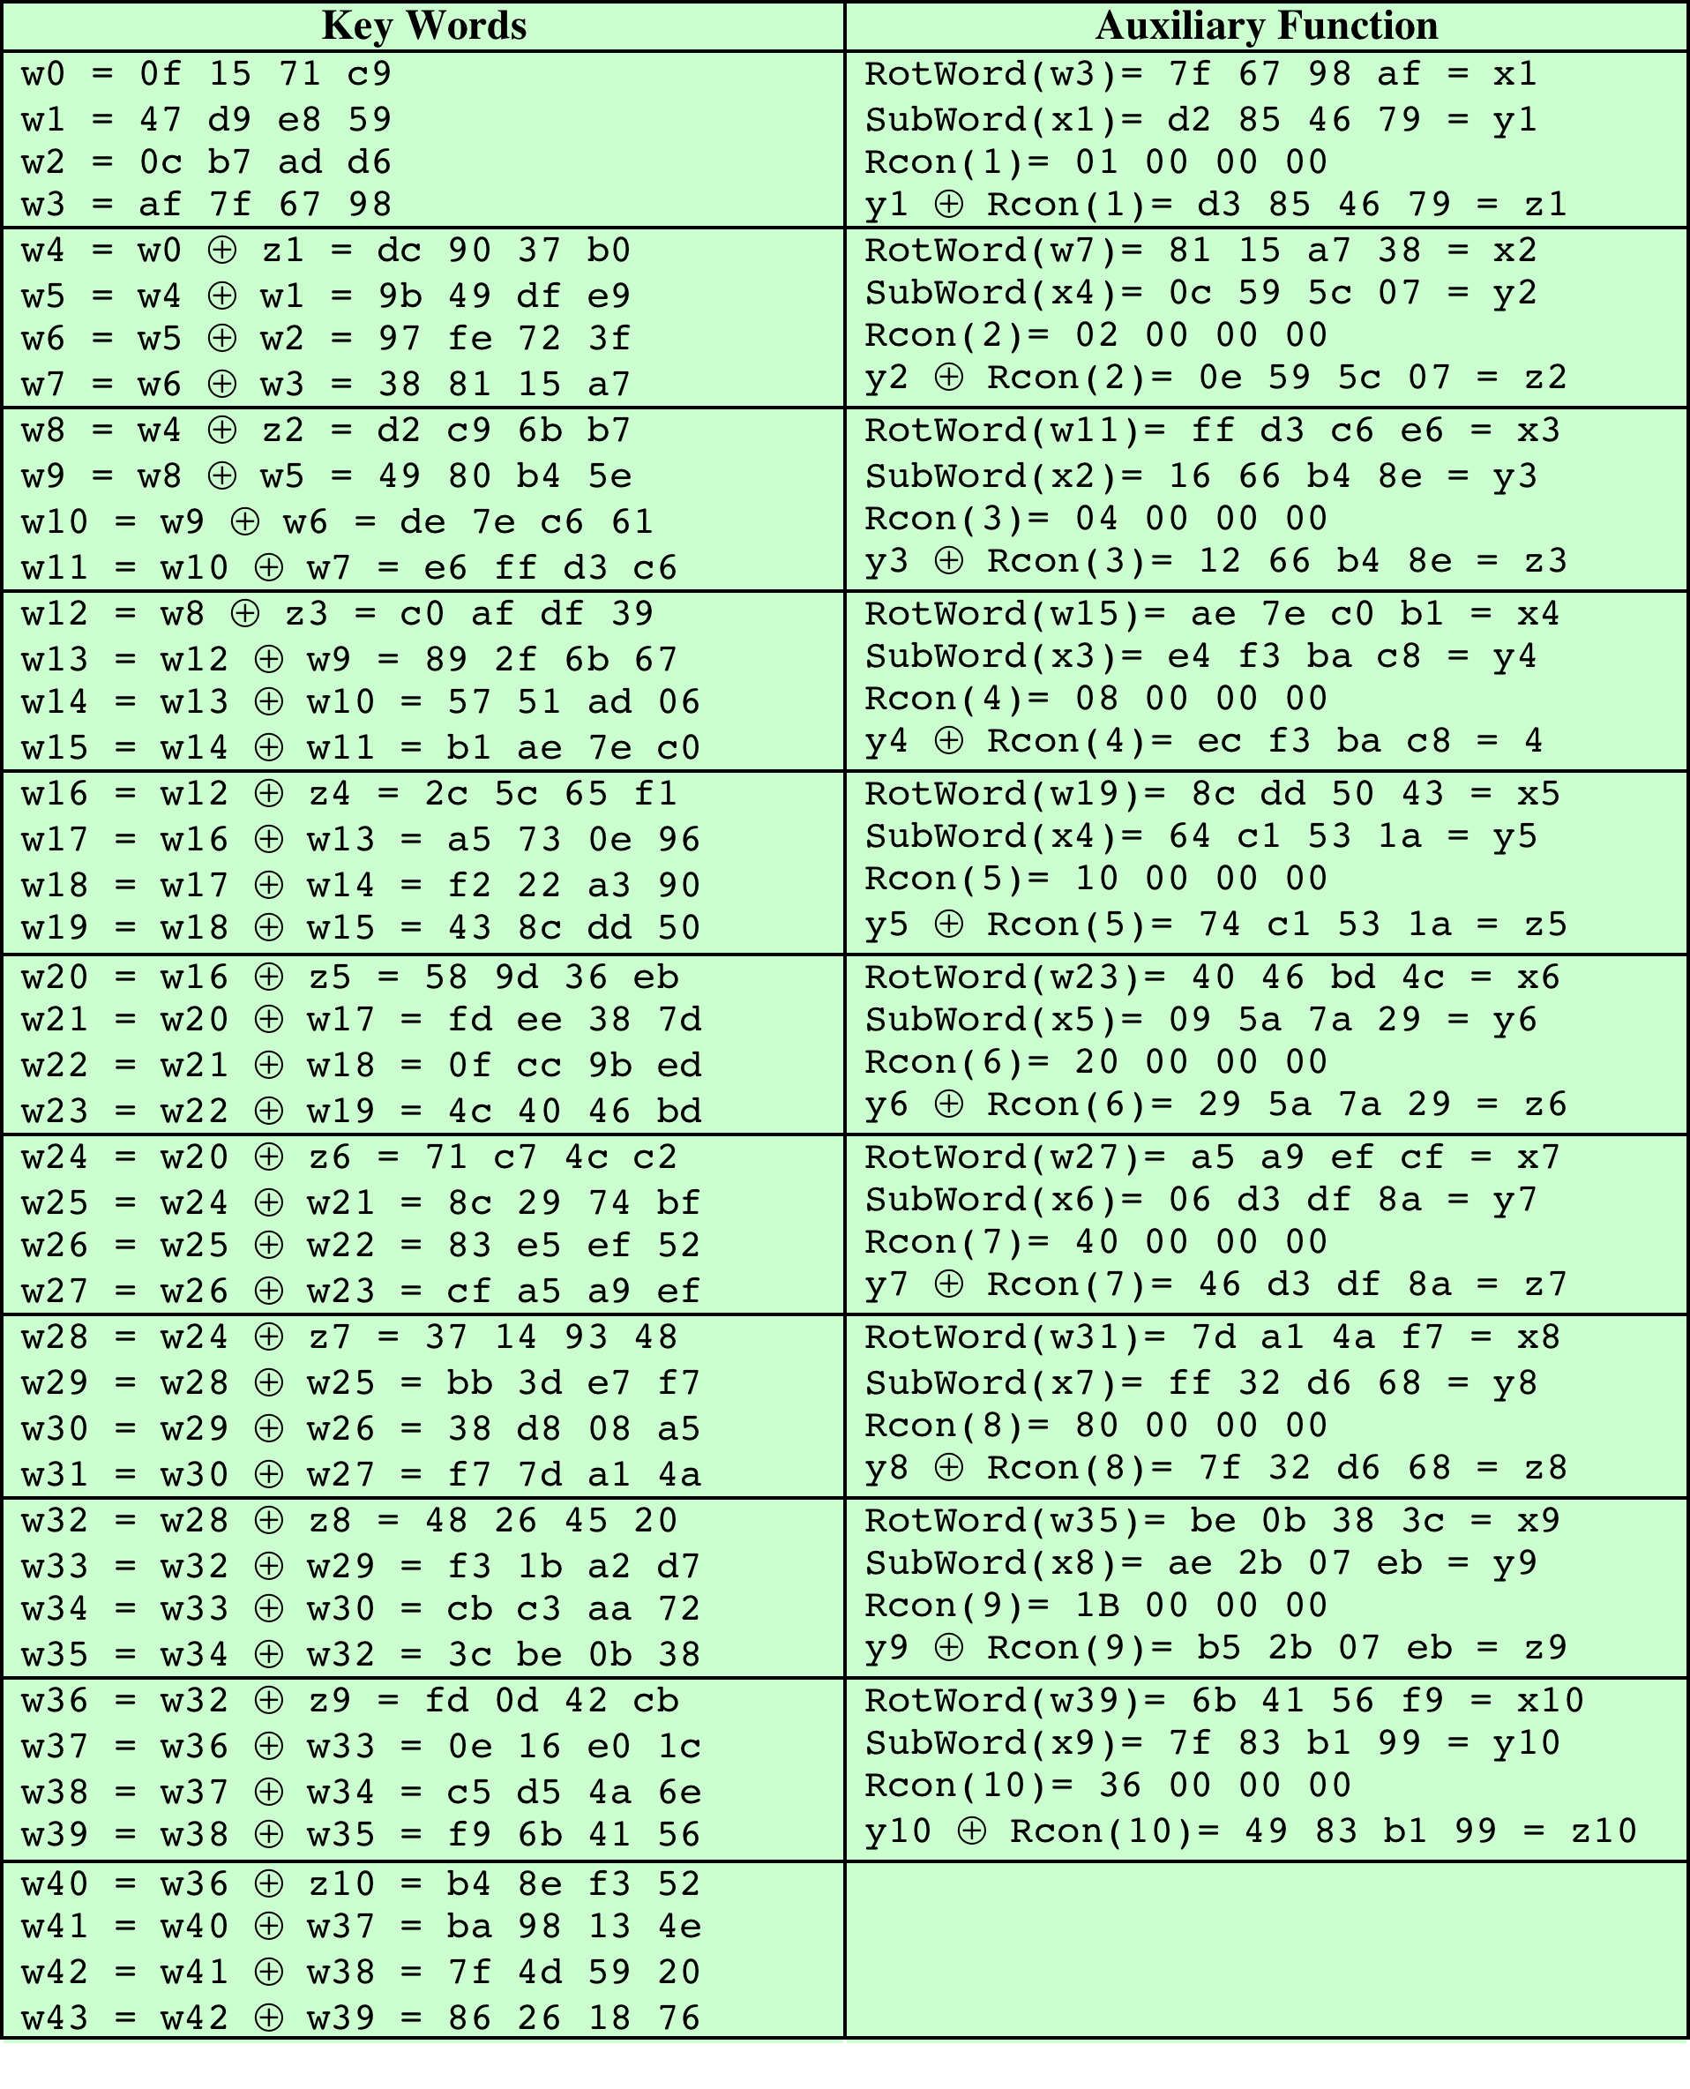
Table 6.3
AES Example Key Expansion
(Table is located on page 175
in textbook)
Notes:
Table 6.3 shows the expansion of the 16-byte key into 10 round keys. As previously
explained, this process is performed word by word, with each four-byte word occupying
one column of the word round-key matrix. The left-hand column shows
the four round-key words generated for each round. The right-hand column shows
the steps used to generate the auxiliary word used in key expansion. We begin, of
course, with the key itself serving as the round key for round 0.

Slide 30
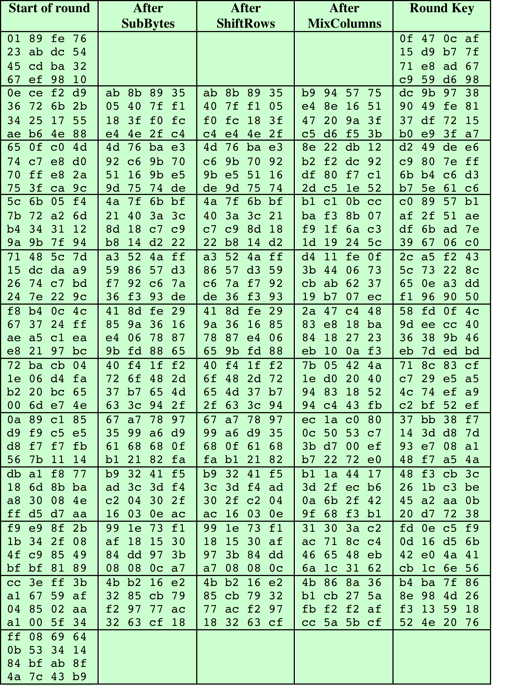
Table 6.4
AES
Example
(Table is located on page 177
in textbook)
Notes:
Next, Table 6.4 shows the progression of State through the AES encryption
process. The first column shows the value of State at the start of a round. For the
first row, State is just the matrix arrangement of the plaintext. The second, third, and
fourth columns show the value of State for that round after the SubBytes, ShiftRows,
and MixColumns transformations, respectively. The fifth column shows the round
key. You can verify that these round keys equate with those shown in Table 6.3. The
first column shows the value of State resulting from the bitwise XOR of State after
the preceding MixColumns with the round key for the preceding round.

Slide 31
Summary
AES transformation functions
  Substitute bytes
  ShiftRows
  MixColumns
  AddRoundKey
  AES implementation
  Equivalent inverse cipher
  Implementation aspects
Finite field arithmetic
AES structure
  General structure
  Detailed structure
AES key expansion
  Key expansion algorithm
  Rationale
Notes:
Chapter 6 summary.

